Slide 1

Black -Scholes Volatility
Straddle Algorithm
Ryan Calicchia

Slide 2
Overview
This project aims to develop an options trading strategy leveraging the Black-Scholes model to identify profitable opportunities through implied volatility analysis. By constructing straddles under specific market conditions, the strategy seeks to profit from price movements or stability, depending on whether realized volatility exceeds or contracts relative to implied volatility.

Slide 3
Hypothesis
The hypothesis is that assets with mispriced implied volatility (IV) can have consistent trading opportunities through straddle strategies:
To achieve profitability:
Dynamically calculate IV using the Black-Scholes model.
Construct and execute straddles when favourable mispricing are identified.
Apply filters for liquidity, IV mispricing, and underlying price action to ensure effective trade selection.

Slide 4
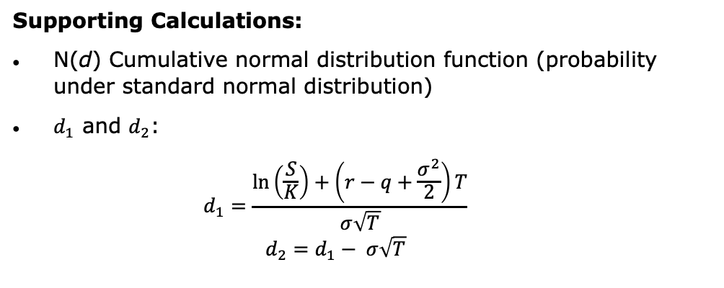
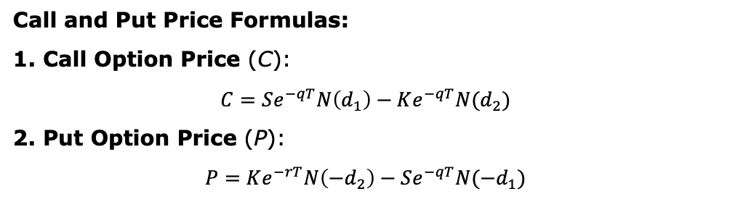
Strategy
Use the Black-Scholes formula to solve for IV (σ):
Inputs:
S: Current stock price
K: Strike price
T: Time to expiration (in years)
r: Risk-free interest rate
q: Dividend yield (if applicable)
σ: Volatility (implied volatility for options)
Call and Put Price Formulas:
1. Call Option Price (C):
$$C=Se^{−qT}N\left(d_{1}\right)−Ke^{−qT}N(d_{2})$$
2. Put Option Price (P):
$$P=Ke^{−rT}N\left(−d_{2}\right)−Se^{−qT}N(−d_{1})$$
Supporting Calculations:
N(d) Cumulative normal distribution function (probability under standard normal distribution)
$d_{1}$​ and $d_{2}$​:
$$d_{1}=\frac{\ln\left(\frac{S}{K}\right)+\left(r−q+\frac{σ^{2}}{2}\right)T}{σ\sqrt{T}}$$
$$d_{2}=d_{1}− σ\sqrt{T}$$

Slide 5
Strategy
Using the Black–Scholes model, it is combined with Brent’s method (a root-finding algorithm) to find the volatility (σ) that makes the theoretical price equal to the market price.
If the average implied volatility calculated (average of the call and put IV’s) is below 50%, the algorithm will place a straddle.
When the average IV is low, option premiums are lower, making it less expensive to enter into positions like straddles.

Slide 6
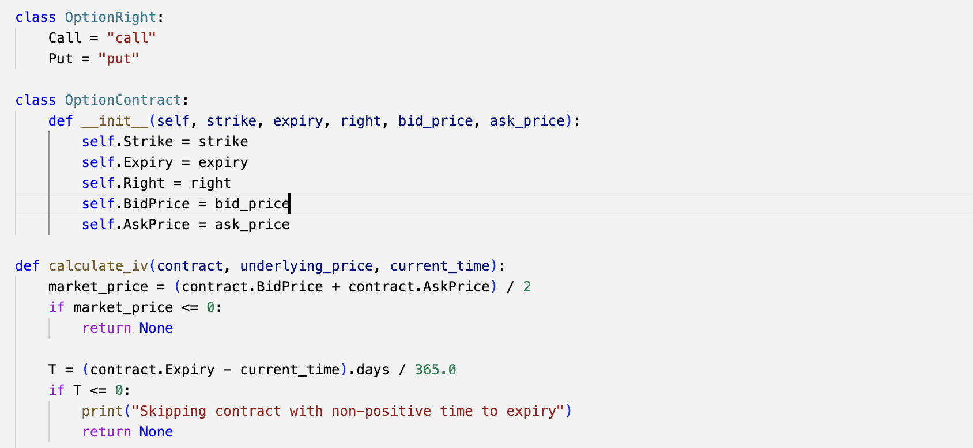
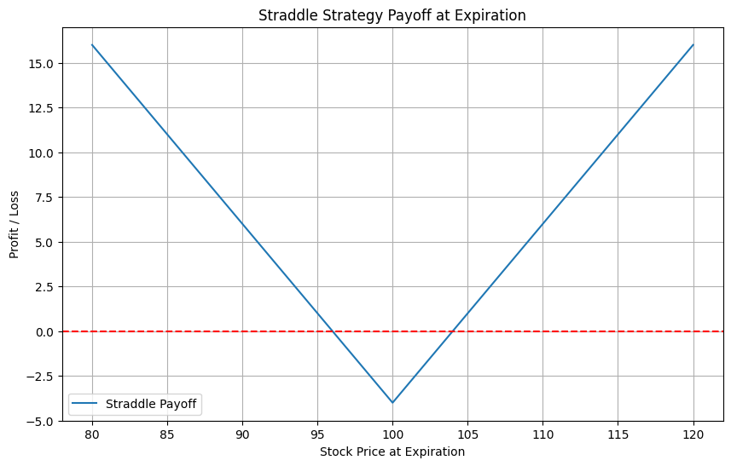
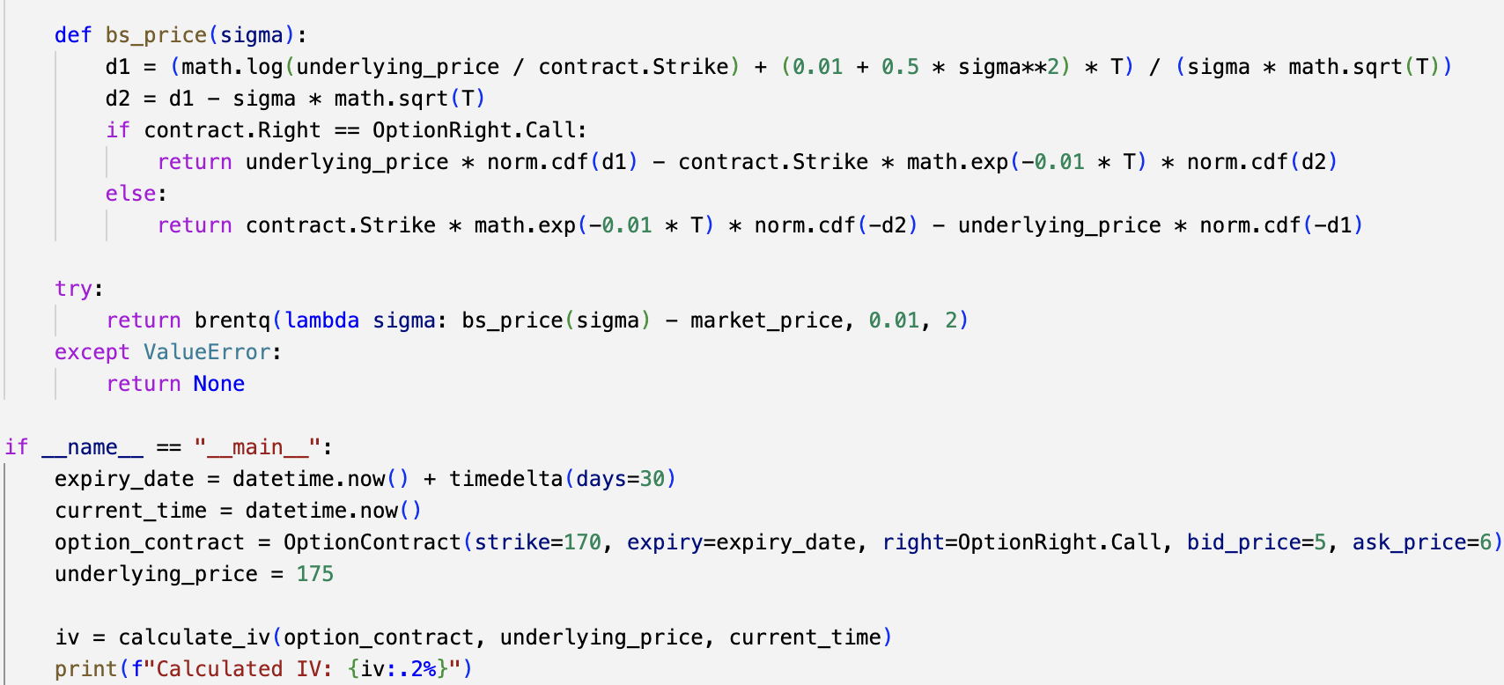
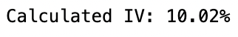
Research
Option premium is $2
Strike price is $100
Stock prices at expiration from $80 to $120

Slide 7
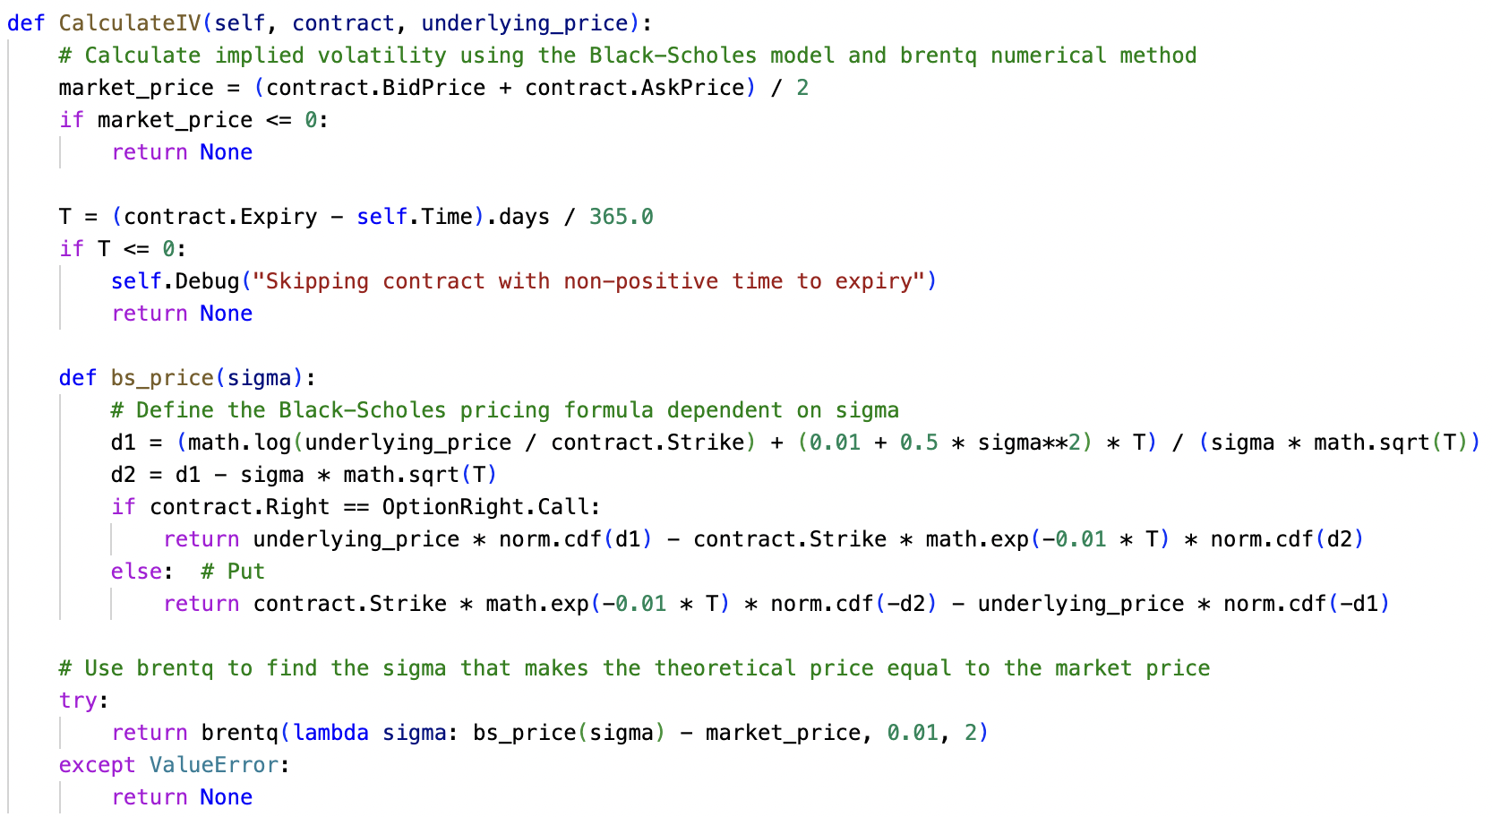
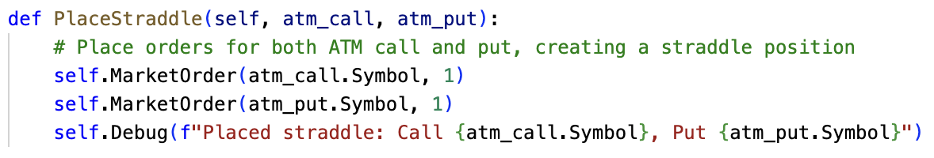
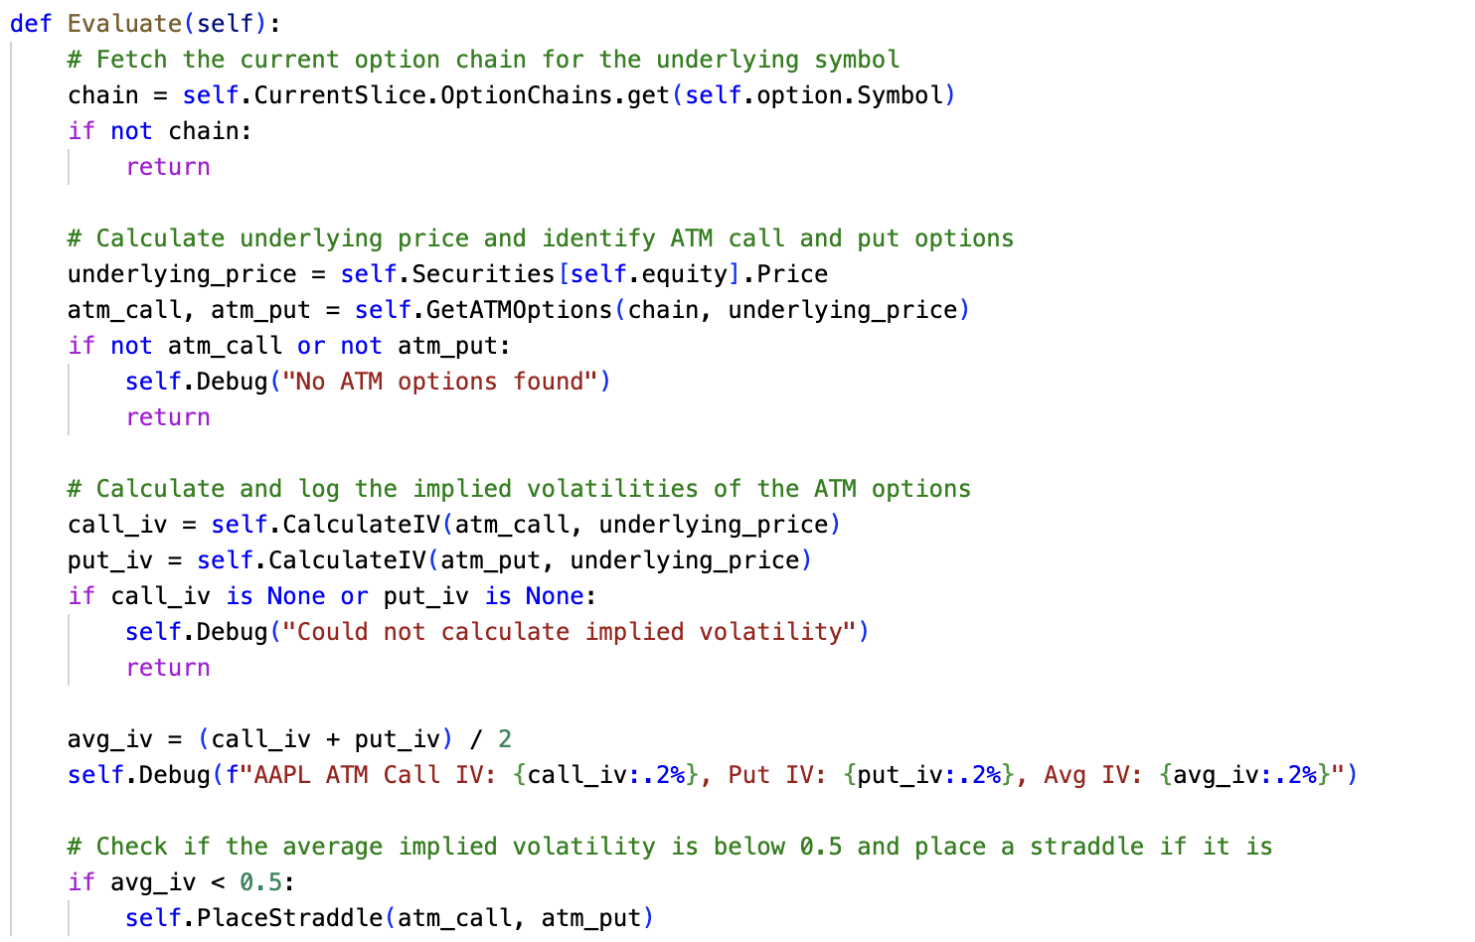
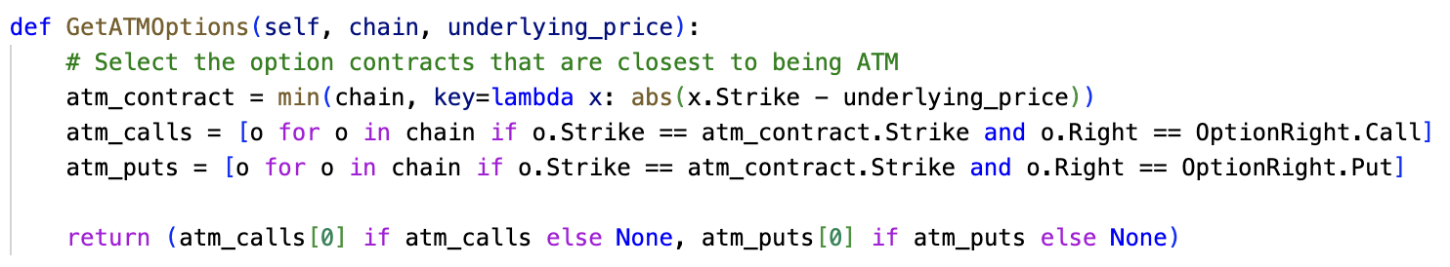
Code

Slide 8
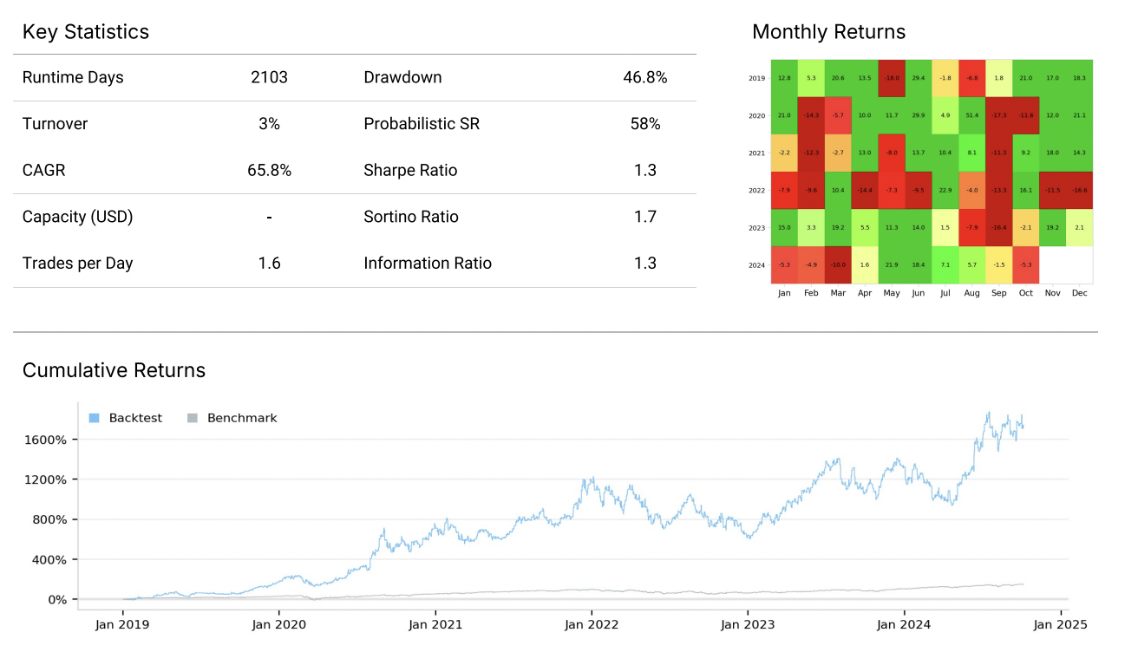
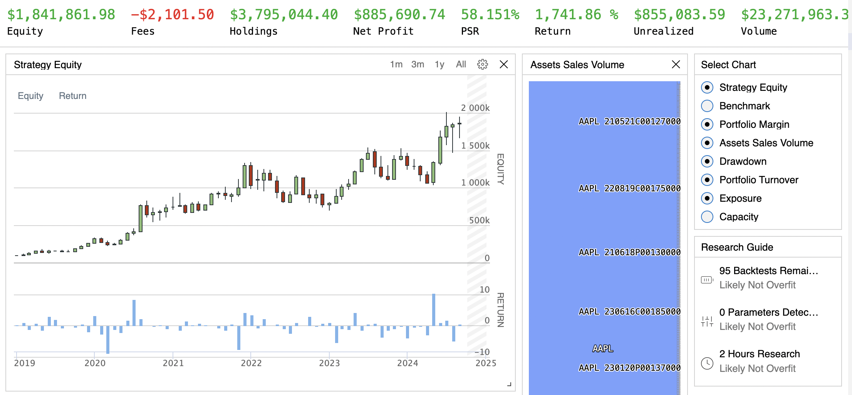
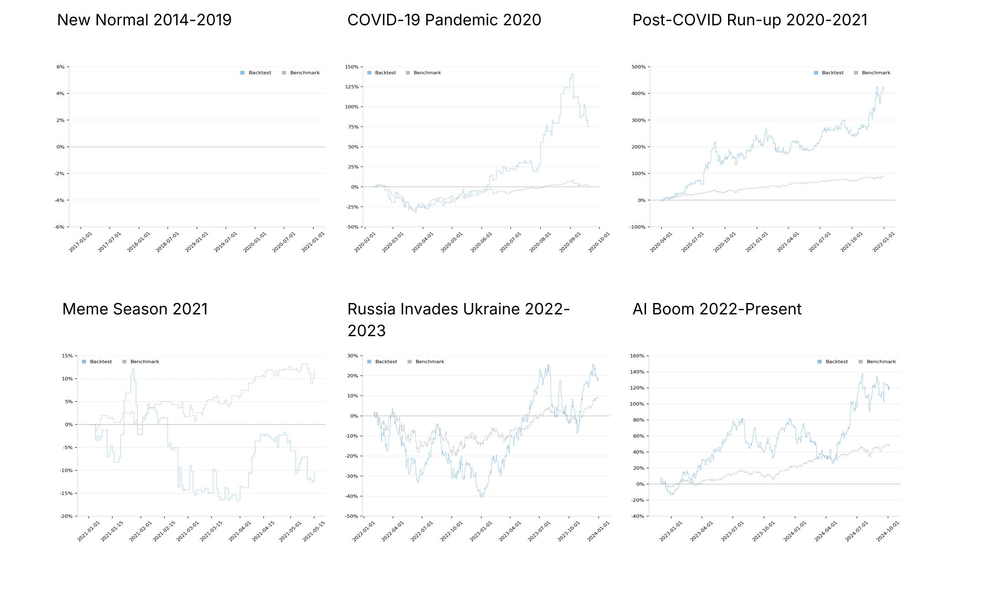
Backtest Results – AAPL 5 Year

Slide 9
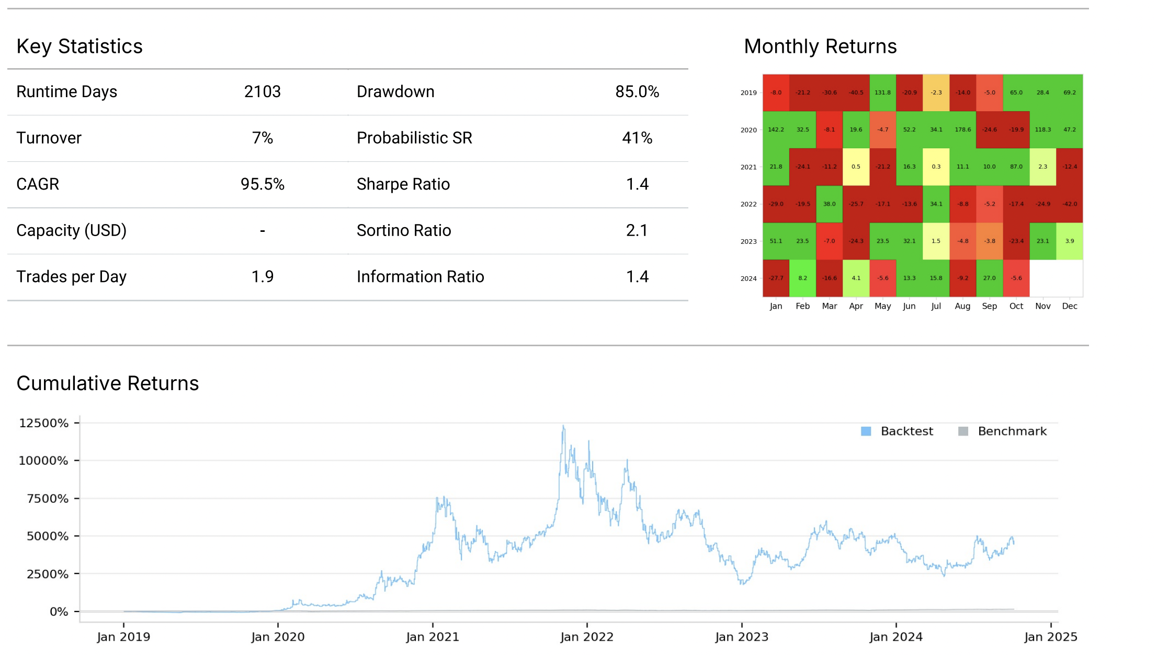
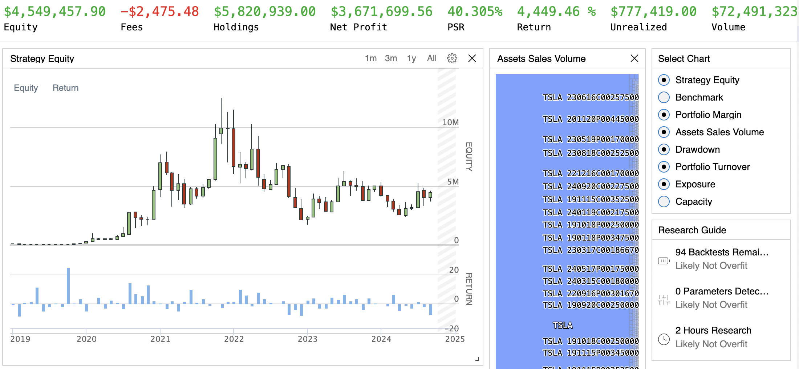
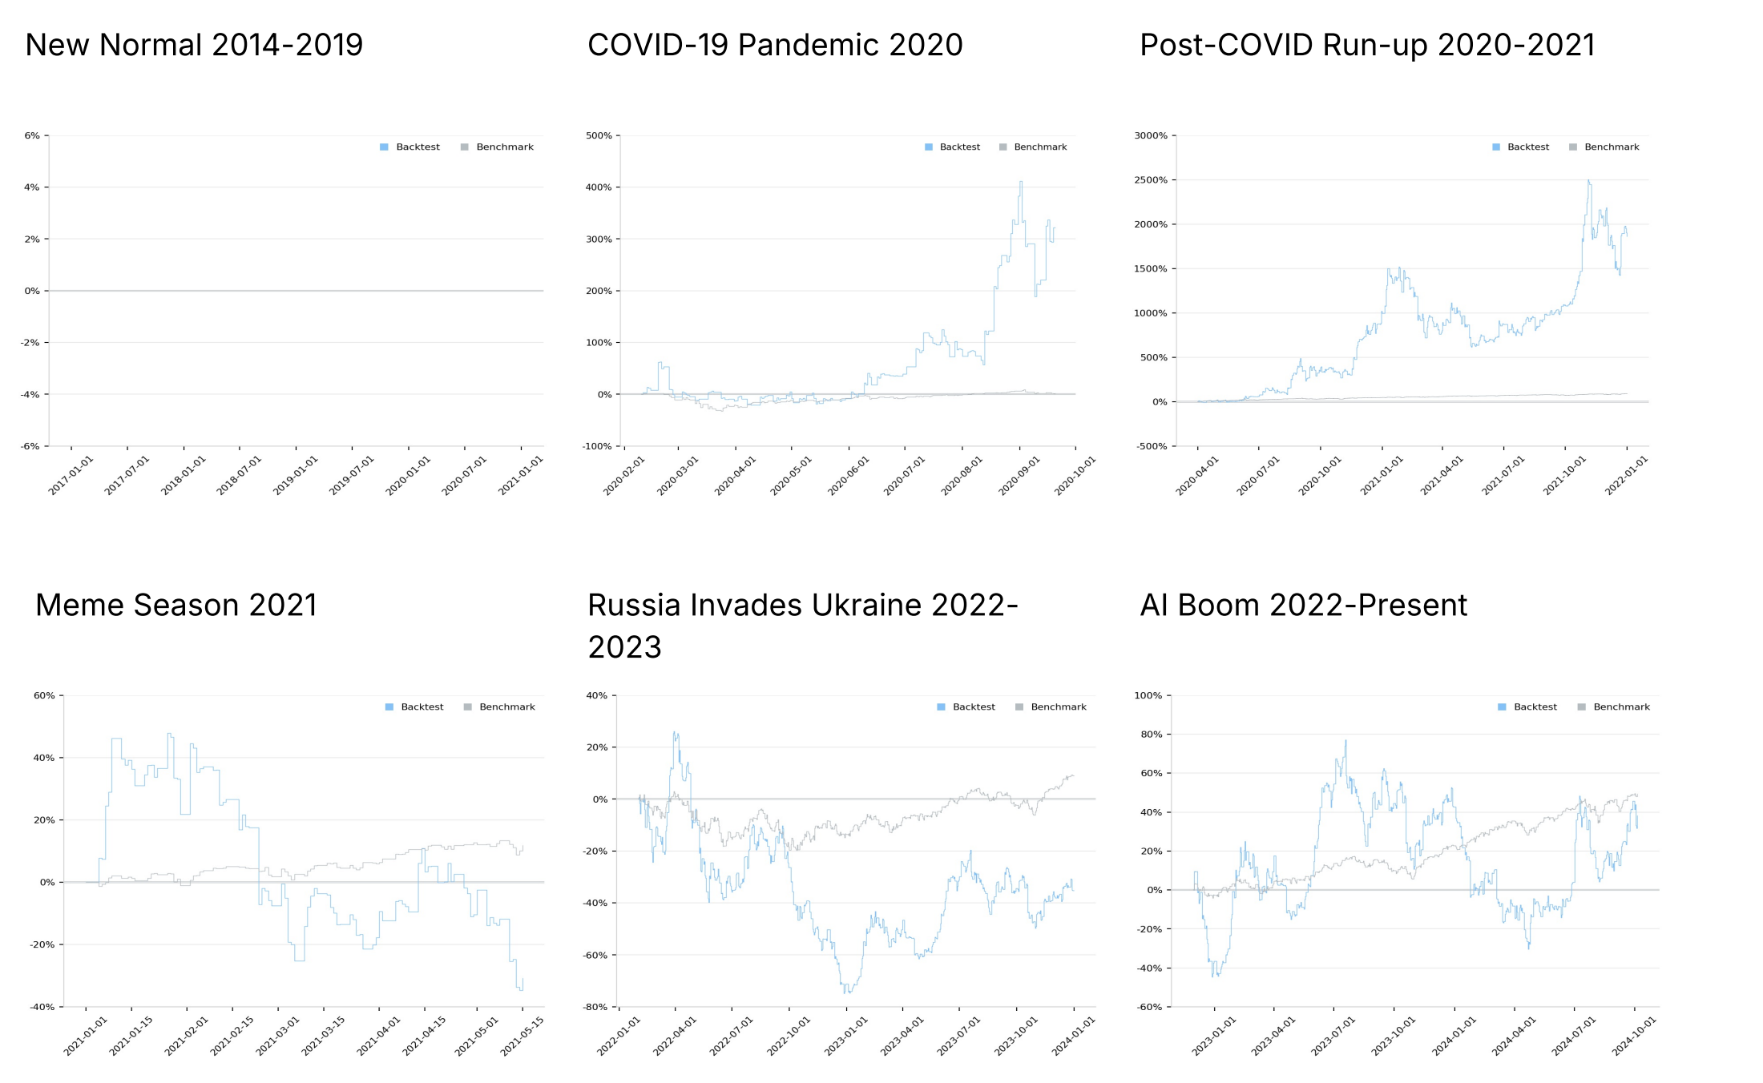
Backtest Results – TSLA 5 Year

